Slide 1
WORK FLOW OF PROJECT
PROJECT TITLE
CLOUD-BASED PATIENT HEALTH MONITORING SYSTEM

Slide 2
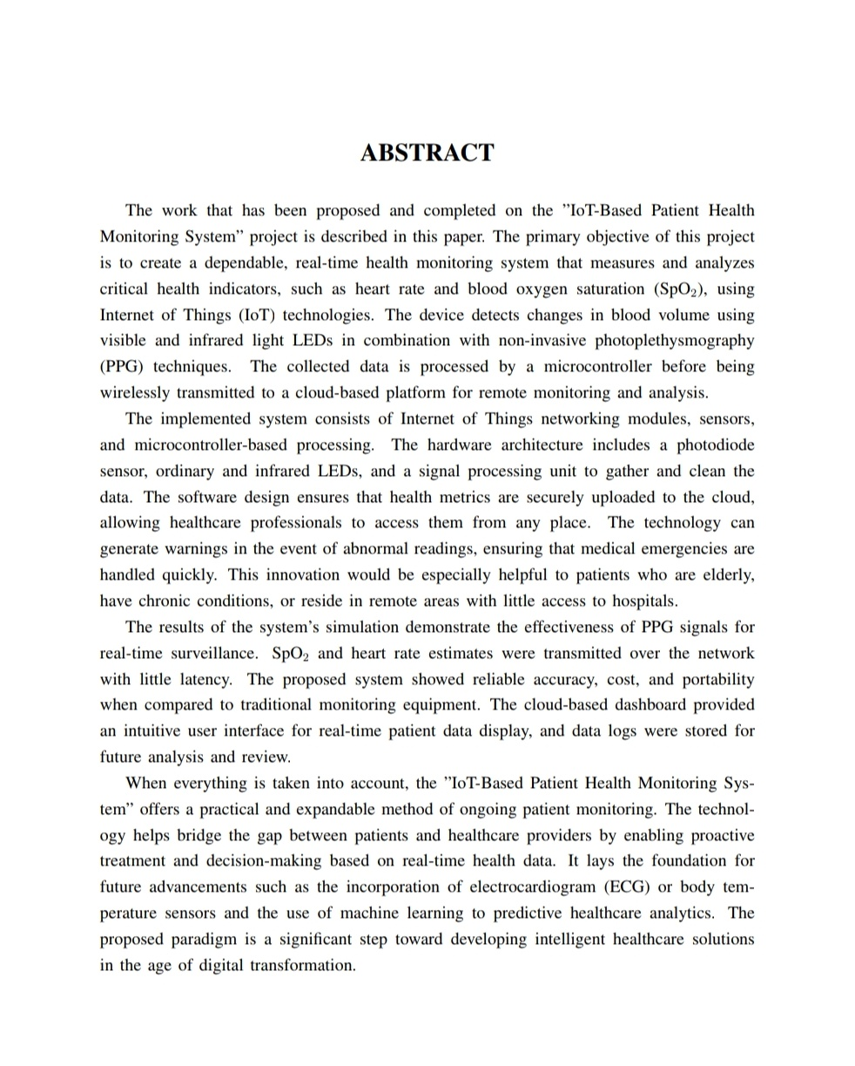
ABSTRACT

Slide 3
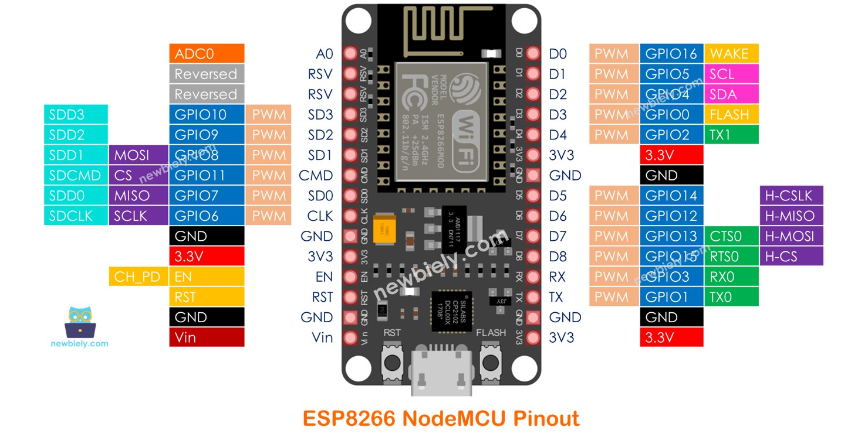
NODE MCU(ESP8266)

Slide 4
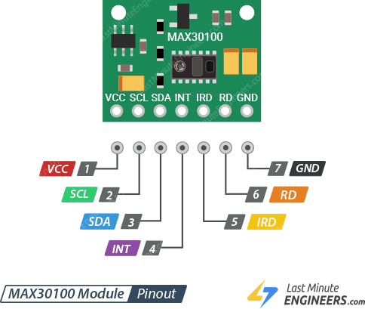
MAX30100(HEART RATE AND SPO2)

Slide 5
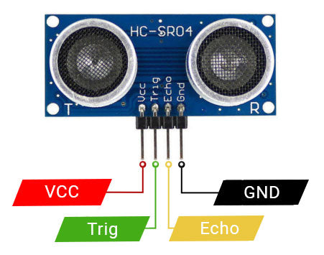
ULTRA SONIC SENSOR(SALINE LEVEL DETECTIONS)

Slide 6
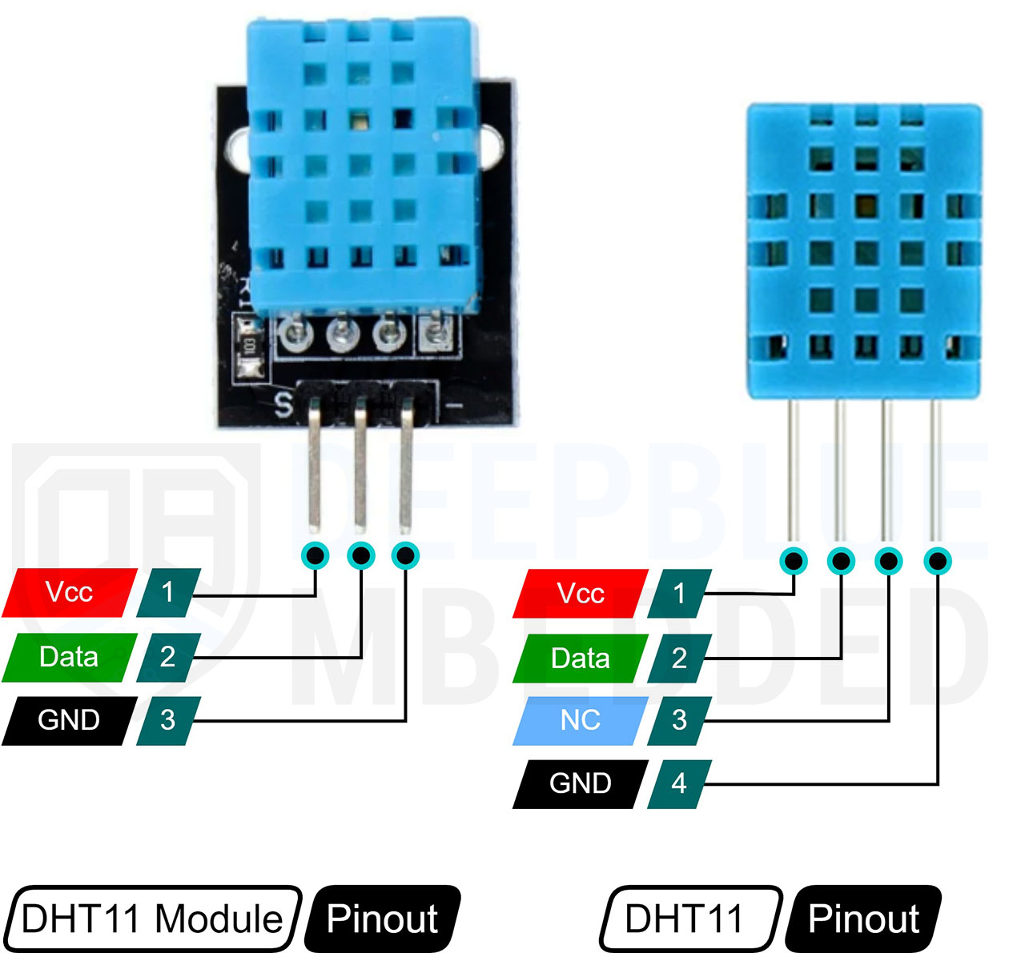
DHT11(TEMPERATURE AND HUMIDITY)

Slide 7
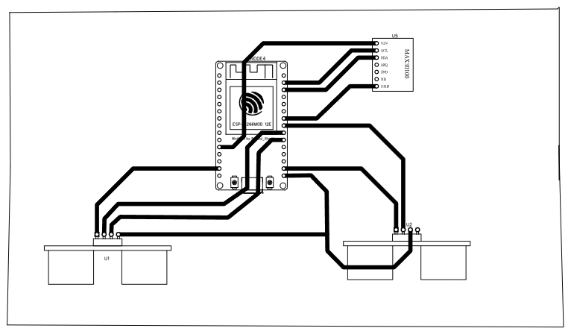
PROJECT PCB DESIGN

Slide 8
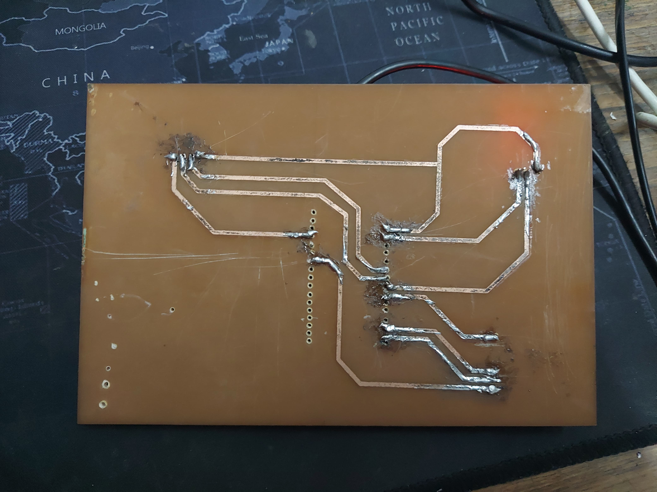
HAND-MADE CUSTOM PCB

Slide 9
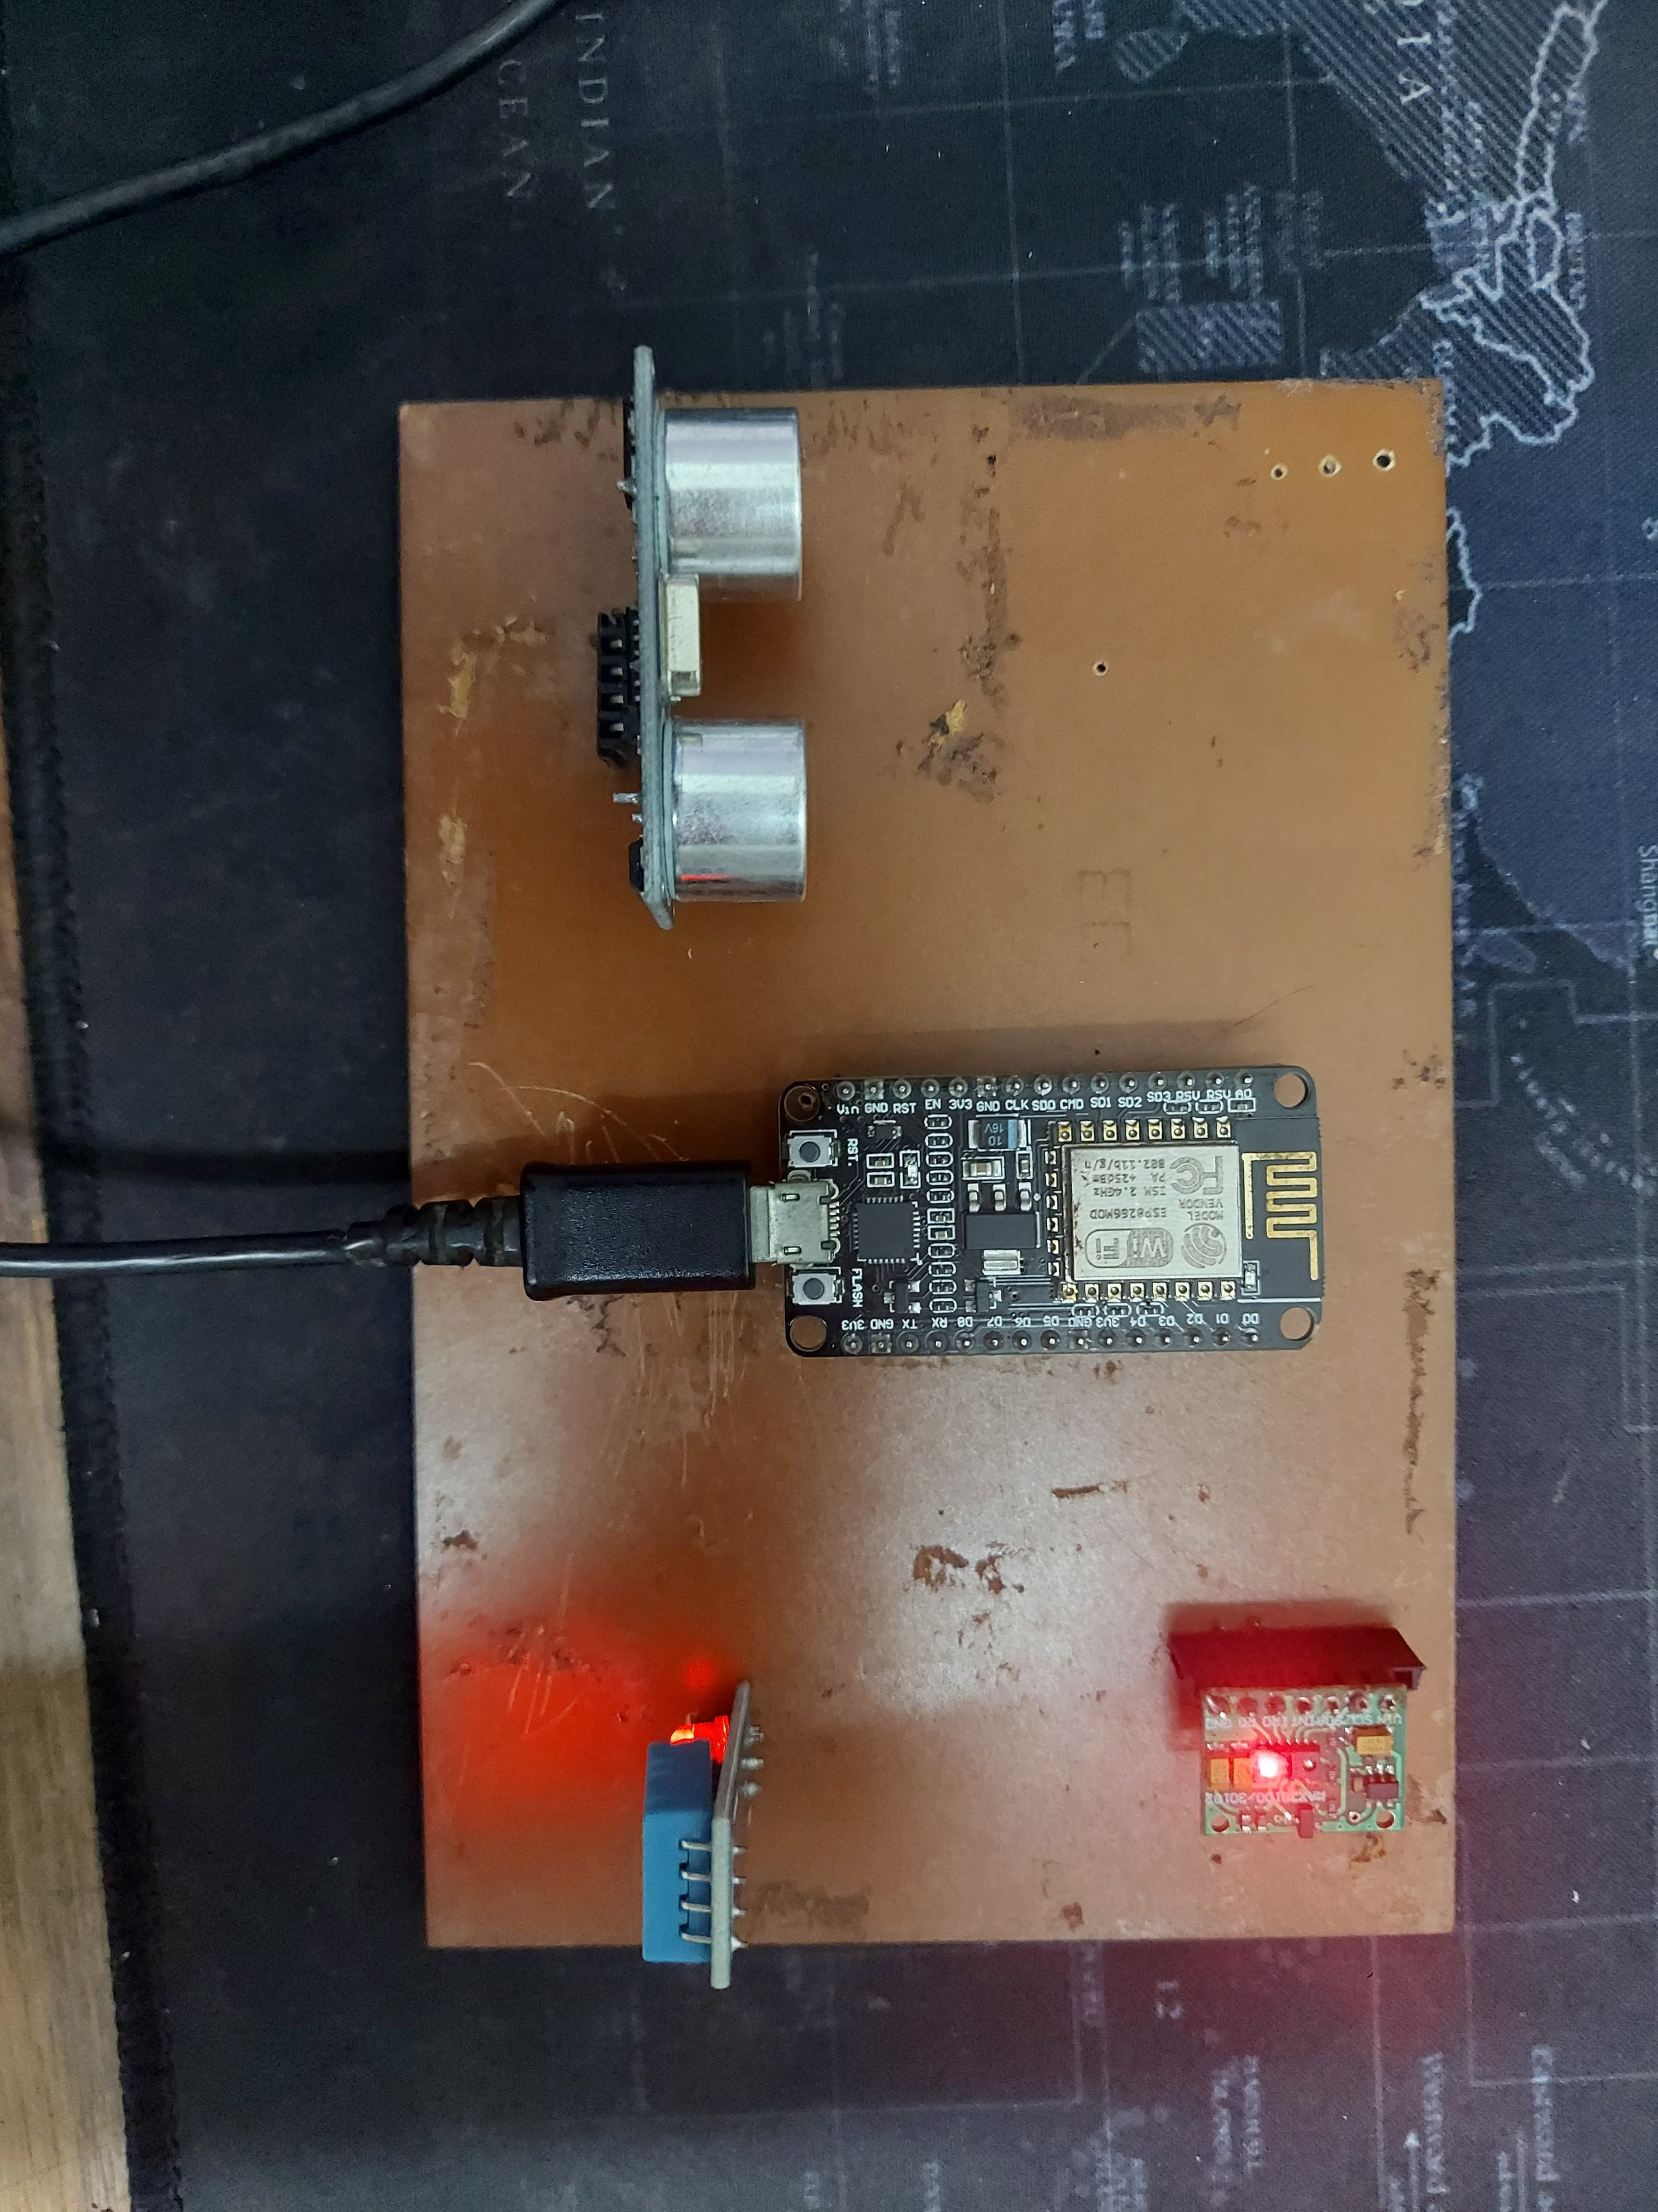
ASSEMBLY OF COMPONENTS

Slide 10
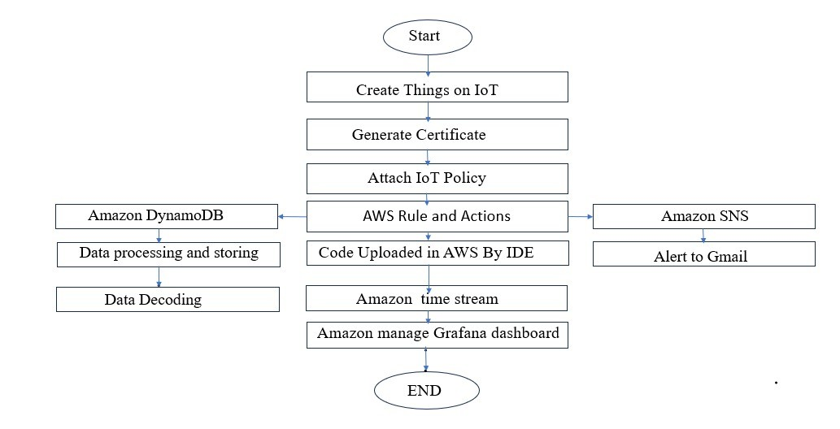
FLOW CHART

Slide 11
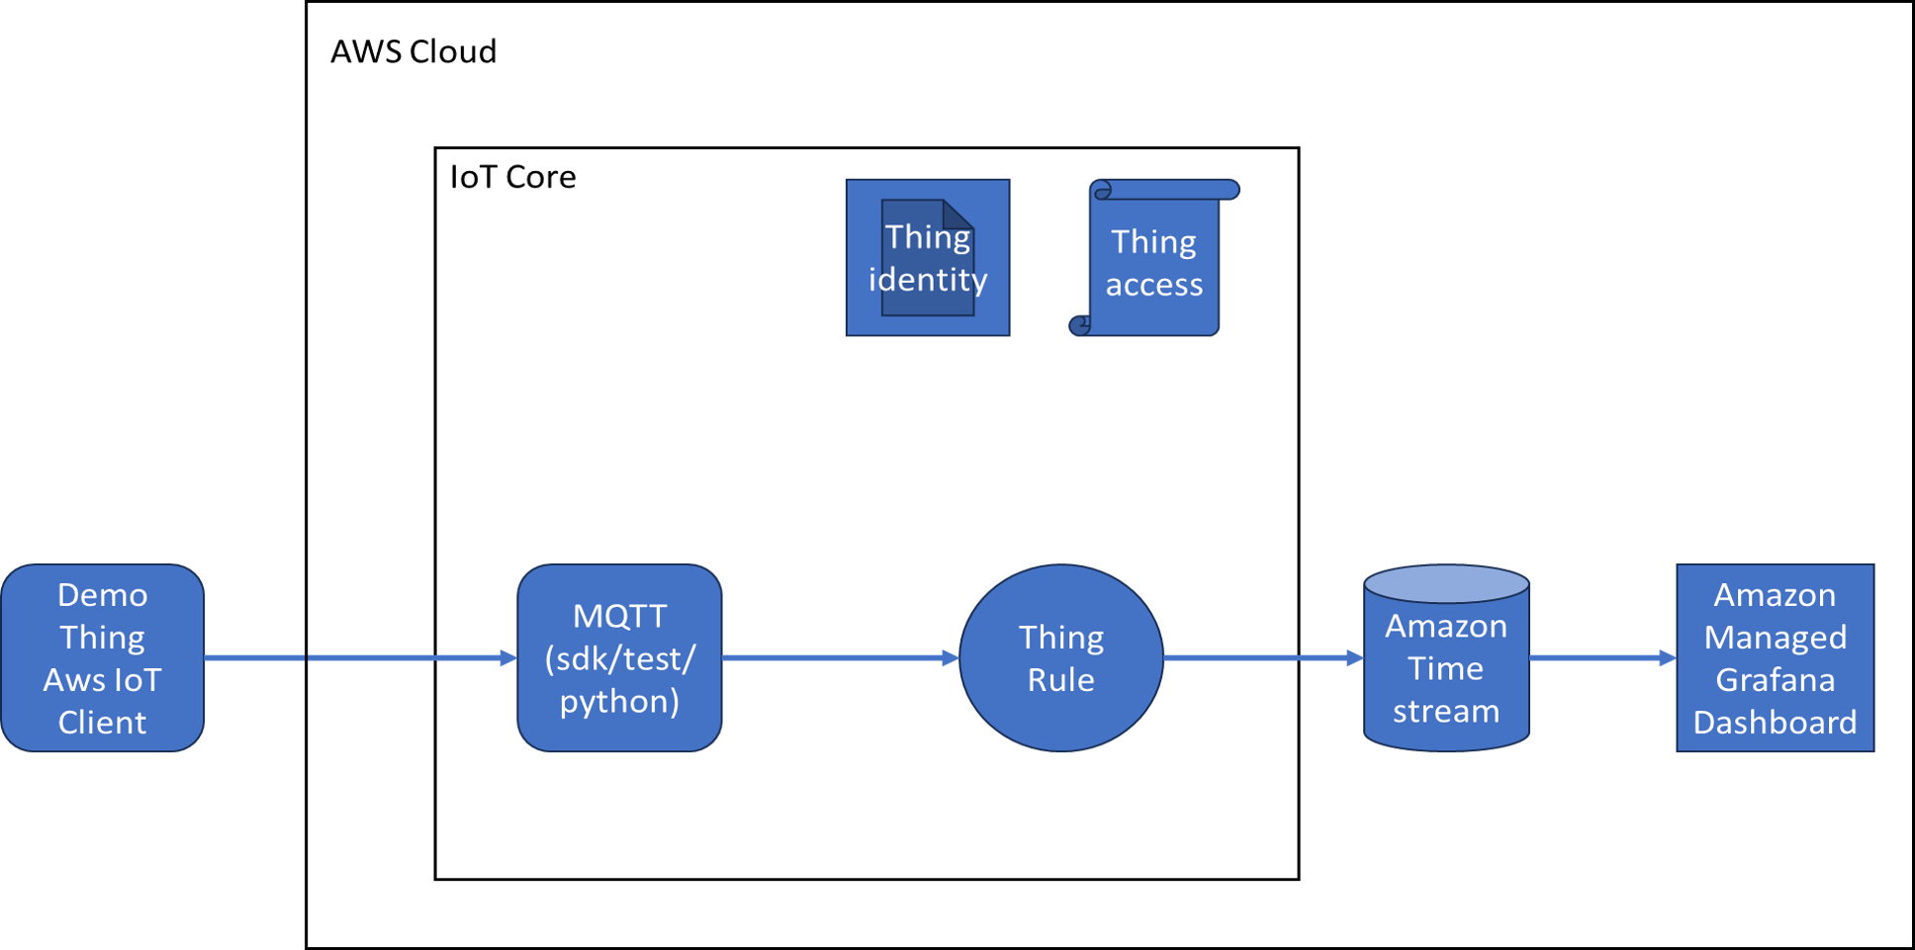
OVERALL IDEA OF PROJECT
Amazon
SNS
Gmail
Alert
Time Decoder
DynamoDb
Data Decoder

Slide 12
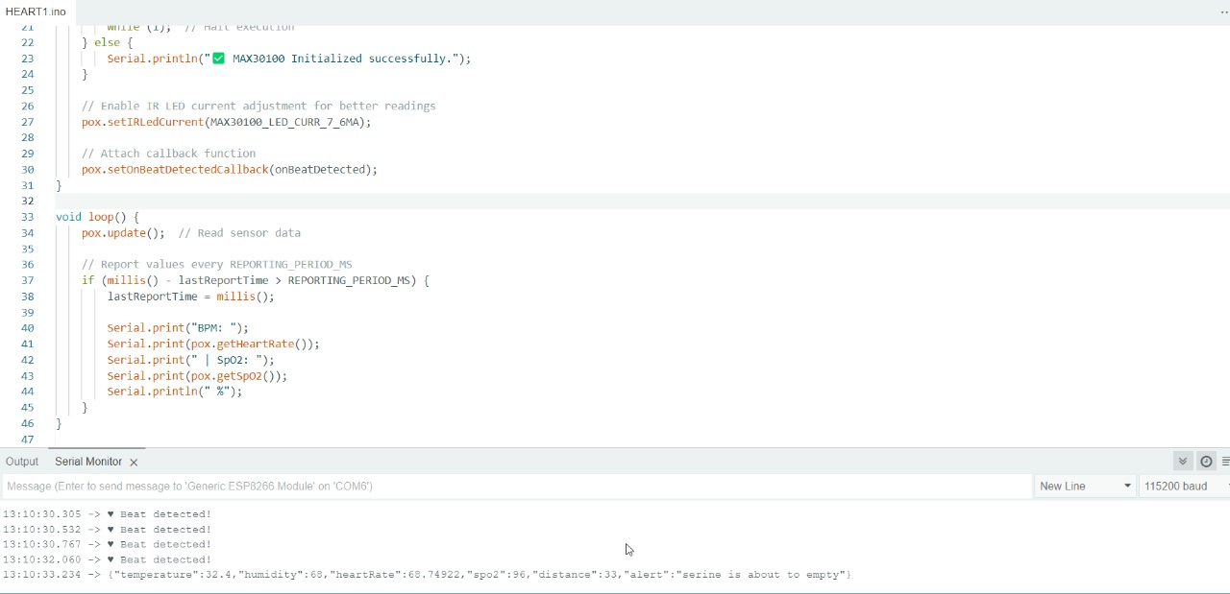
Arduino IDE code to connect components to AWS IoT Core over Wi-Fi using MQTT:

Slide 13
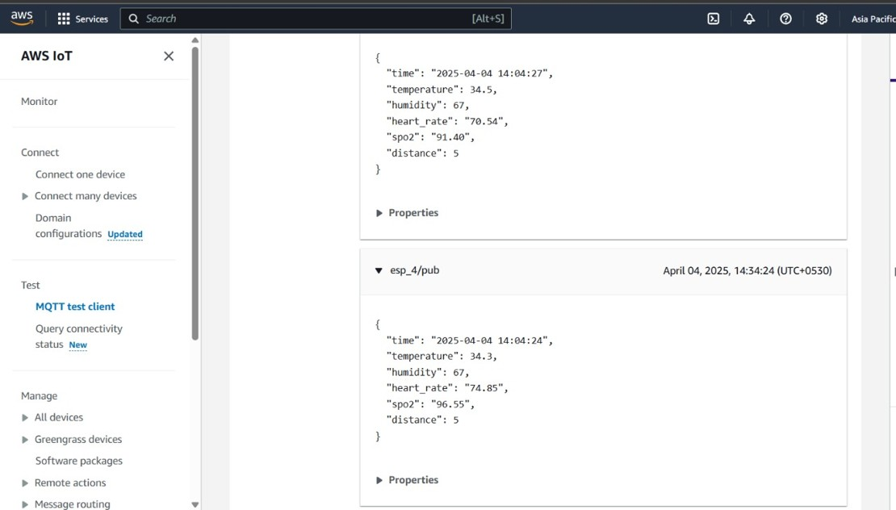
DATA PROCESSING IN AWS CLOUD:

Slide 14
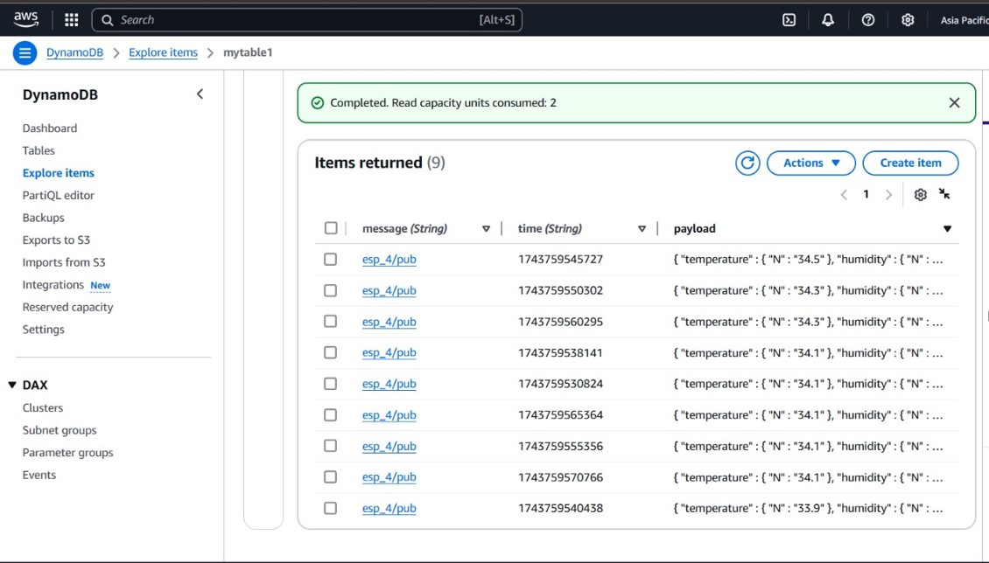
DYNAMODB FOR DATA STORAGE:

Slide 15
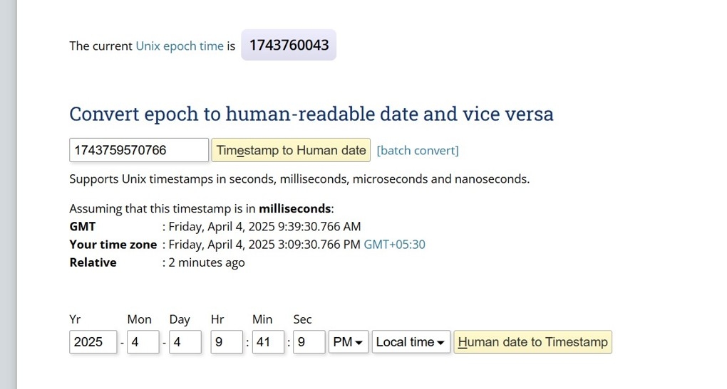
Real-time data logging with date and time for any stored data:

Slide 16
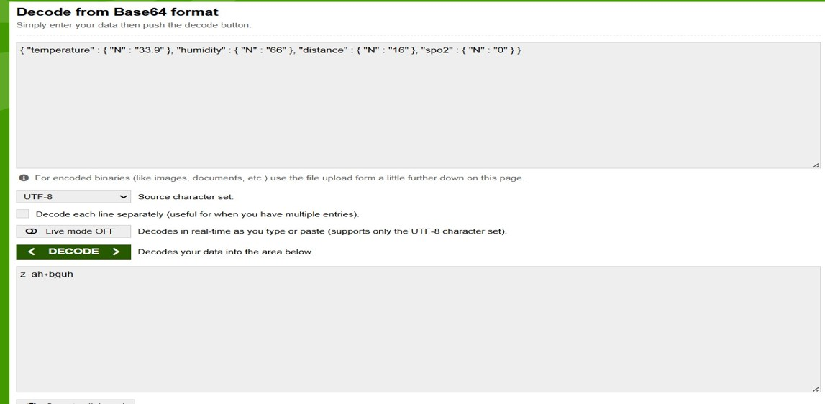
ANY STORED DATA DECODING FROM AWS:

Slide 17
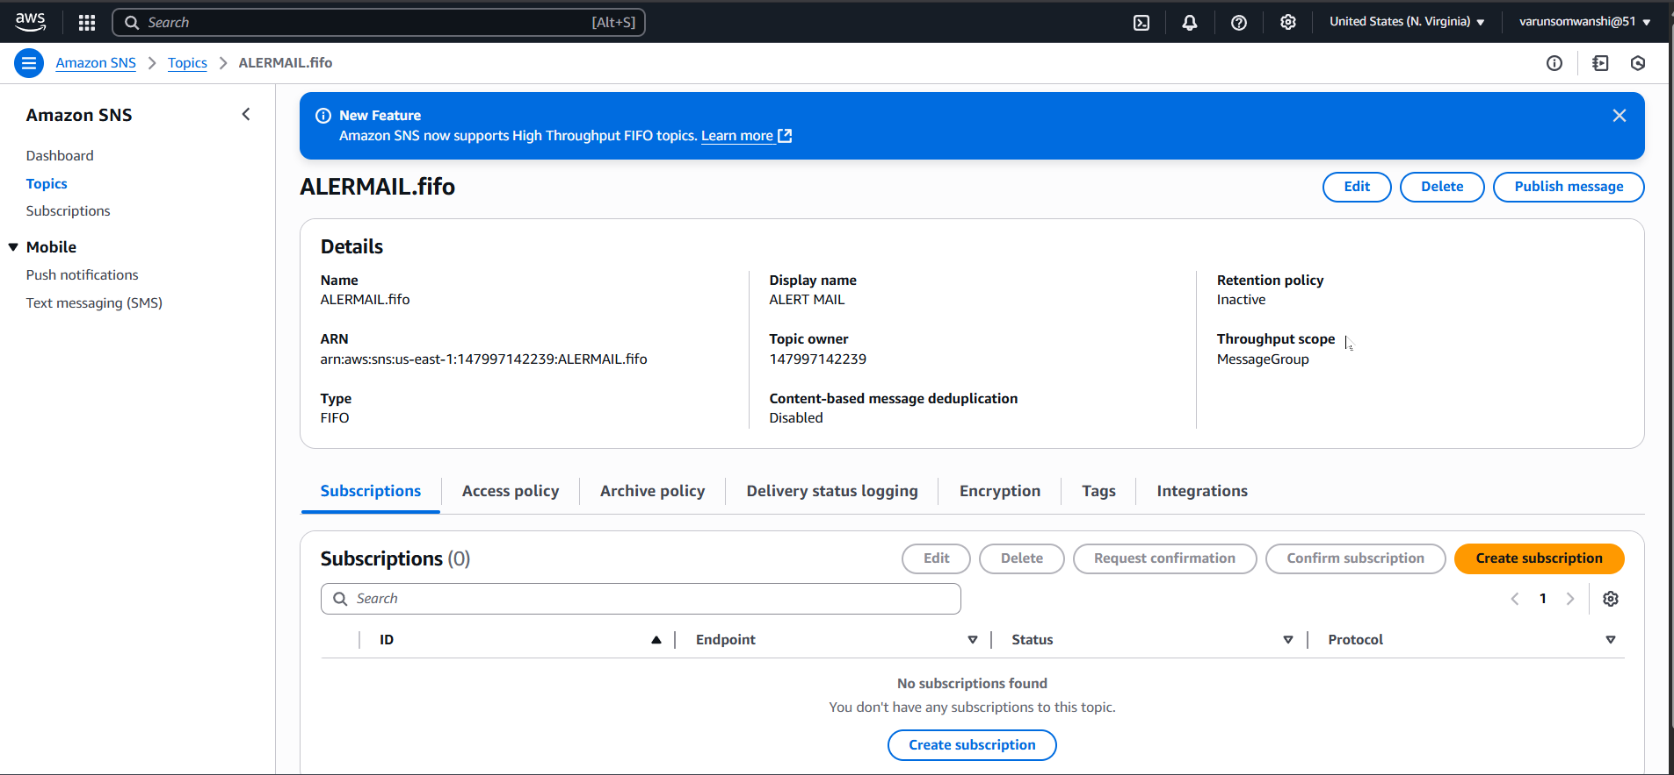
Real-time alert emails are sent using Amazon SNS:

Slide 18
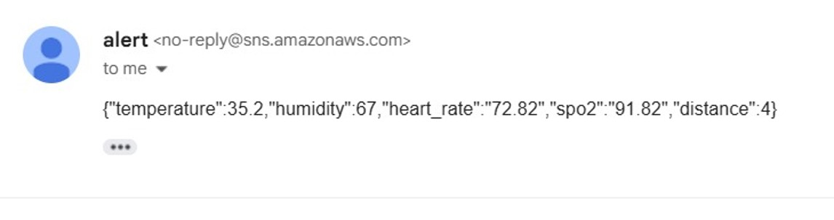
EMERGENCY THRISHOLD HIT ALERT MAIL IN GMAIL:

Slide 19
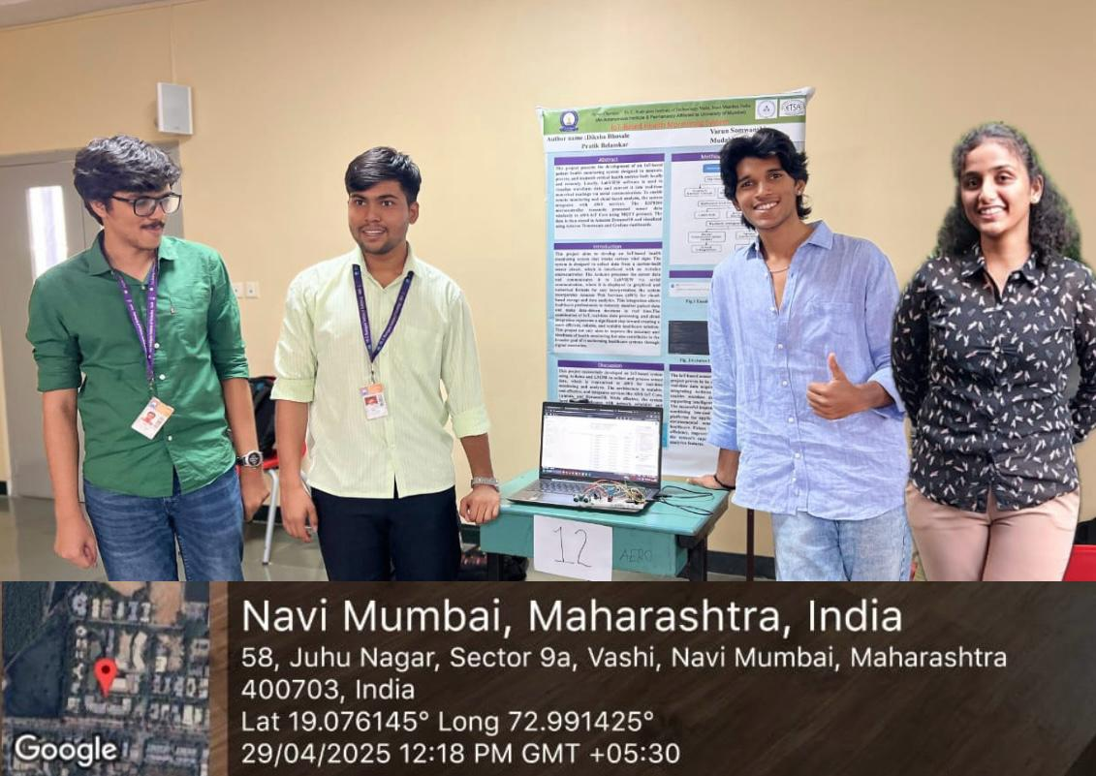
PROJECT TEAM:

Slide 20

Certificate:

